Slide 1
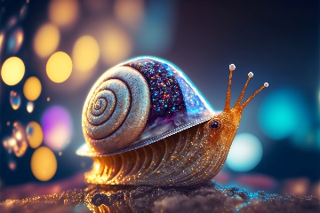
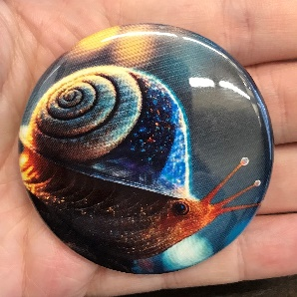
Large Button Template
Overview
Black circle is the cut line, all paper used in this circle will go into the button maker. Do not delete it.
What you send us
Yellow circle is the image guideline. Keep the parts of the image you want to see in this circle.
Anything between the circles will wrap around the back of the button.
What we send you
Instructions
1. Insert your image
2. Right click image, send to back
3. Align image as desired within circle
4. Delete yellow circle once satisfied with alignment
5. If you use any text, “save as” file as a .pdf to preserve font choices
6. Save, and submit your template file on the request form at luc.edu/buttonmaking
The circles below are the exact size needed for the button maker,
DO NOT RESIZE CIRCLES

